Slide 1



Welcome
Core Banking Solution (CBS)
Turnkey Solution provider
Total Solution for
Total Satisfaction
©
3, Central Excise Colony, Near Chhatrapati Square, Ring Road, Nagpur - 440015,
Maharashtra , INDIA

Slide 2

About VGIPL
Founded in Year 1997, A Total end to end Global IT solution provider.
Two Decades of Domain Expertise in IT / BFSI / e-Governance.
An ISO 9001, 20000, 23001 & 27001 certified organization.
Pioneer in delivering Core Banking / ERP / E-Governance / DC / DR Solutions.
Dedicated team of experts for delivering an end to end IT solution.
Team of 250+ Engineers & Support Staff.
Customer base of 150+ National and International Organizations.
Cost Effective and Customized Software Solutions and Services.
“Believes That The Essence Of Good Work Lies in Team”

Slide 3




Flagship Products
Core Banking Solution for:
Commercial, Co-Operative, DCC Banks, NBFCs, Microfinance Implemented in 50+ Banks & Co-operative Societies
Built on Web based ASP.Net & Oracle Technology & Mobile Technologies
IBS ERP Solution for:
Solvex, Sugar, Steel , Fertilizer & Seed, Power & Explosive, Textile Industry. Offered ERP solution to more than 50 clients
Built on Web-based Java / ASP.Net & Oracle Tech. & Mobile Technologies
VPay Solution for:
The Absolute Merchants Payment System:
Start collecting payments via V-Pay through multiple channels.
Built on Mobile & Cloud Platform.
e-Governance solution for:
E-Auction/E-Tendering & Office Automation software for APMCs Implemented in 25 APMCs across Maharashtra
Built on Web-based ASP.net & Oracle Tech. & Mobile Technologies

Slide 4
IT Infrastructure Management
Data center & Disaster Recover Site Build & Management.
IT Infrastructure : Sales, Service & Maintenance.
Servers, Desktops, Printers, Scanners, Power Backups.
Network Infrastructure : Sales, Service & Maintenance.
LAN, WAN, VPN, Wireless with Routers, Switches, etc
OS & Database : Sales & Service.
Windows, Linux, Oracle, My Sql
Customized Applications : Service & Maintenance.
Security & Disaster Recovery : Service & Maintenance.
Our core competency of this segment is integration of the high-class and cost effective solutions with the brand you desire…!

Slide 5

Core Banking Solution (CBS)
Segment: Banking
Product Type : Web Based
Launched At : Year 2008
Front End : ASP.Net, Java scripts.
RDBMS : Oracle 12c or higher
Server OS : Windows, Linux
Client OS : Windows
Web Server : Apache Web Server
Browser : Internet Explorer 7.0 or equivalent

Slide 6
Software Product Modules
Head Office Operations with (OSS).
Anti-Money Laundering – AML.
Asset Liability Management – ALM, LOS & Credit Appraisals.
Fraud Risk Management System (FRMS).
GST Module
General Insurance
Internet Banking Module.
Mobile Banking Module.
DIGI Locker, Chatbot’s, Mobile Wallet Integration
Biometrics login.
Online Complaint Module.
C-KYC
ATM/POS/Kiosk/Rupay Card Interface for Switch.
NEFT/RTGS Server Interface for Switch.

Slide 7
Software Product Modules
NFS Interface for Switch.
HR/Payroll Module.
CTS Module.
ECS NPCI.
DBTL Module.
Aadhaar Enabled Payment Service (AEPS)
Unified Payment Interface (UPI)
Immediate Payment Service (IMPS)
Bharat Bill Payment System (BBPS)
Micro-ATM
E-Commerce & Payment Gateway Integration
Pradhan Mantri Jeevan Jyoti Bima Yojana (PMJJBY)
Pradhan Mantri Suraksha Bima Yojana (PMSBY)
Atal Pension Yojna (APY).

Slide 8
Software Product Modules
SMS Gateway Interface
Reconciliation Br to Br, Br to Ho & Bank to Bank.
Locker Module.
Court Module.
Risk Calculation Module.
TDS Maintenance Module.
Management Information System (MIS) & Business Intelligence (BI) Tool.
Customer Merging.
Report Designer module.
Share Module.
Financial Inclusion Module(FI).
DRD/Pigmy Machine Interface.
DEAF Module.
Stock/ Fixed Asset /Dead Stock Maintenance.

Slide 9
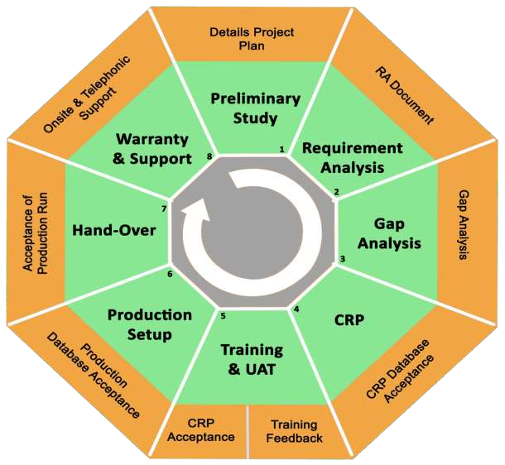
Approach & Methodology

Slide 10
Software Product Features
Centralized Any Branch Transactions (CBS)
24*7*365 Connectivity,
Complete Branch/HO Operations.
Support P.O.S. enabled.
Support Biometric/ Card enabled.
Software Support Bilingual & Multicurrency .
Single window Concept.
Working with 8 different Switches.
Auto Interest calculation and posting.
Auto Day end

Slide 11
Software Products Security Policy
Security on Machine Level- Id stored in database.
Security on User level with encrypted password.
Security on User Login attempt.
Security on Branch level.
Security on Database level.
Security on Branch Terminal Level.
Security on Module.
Security on User level .
Security on Menu Level.
https URL with http protocol and SSL.
Make own data encryption and decryption algorithm (security certificate).

Slide 12
VGIPL Mobile Banking Functionality
VGIPL offers banks with the ability to give their customers “anywhere and anytime banking” facility. Customers can operate their accounts by installing a mobile app on their device.
VGIPLs’ Mobile Banking Offers convenient means of banking with secured and safe channels.
Seamlessly integrated with core banking solution and other channels using ISO 8583 Protocol.
Can be installed on any Android / IOS / Microsoft based Smart phones.
Anywhere Anytime Banking - 24X7 using IMPS.
Bill payment, online booking and various other tasks have been simplified due to VGIPLs’ mobile banking app.
It shall help people to initiate financial transactions on the go.

Slide 13
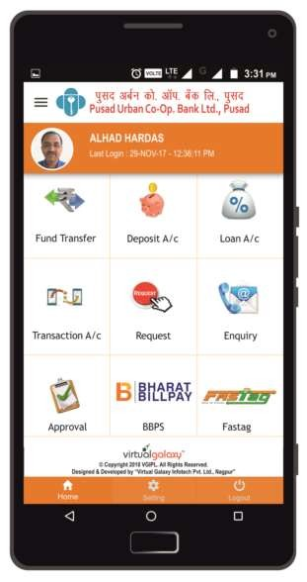
Mobile Banking Home Screen
After logging in, system displays different
menus / options available in mobile app:
Fund Transfer
Deposit A/c
Loan A/c
Transaction A/c
Chequebook Request / Stop Payment Request
Enquiry
My Card
Approval etc.

Slide 14
















VGIPL Selected Client List Banking Projects

Slide 15
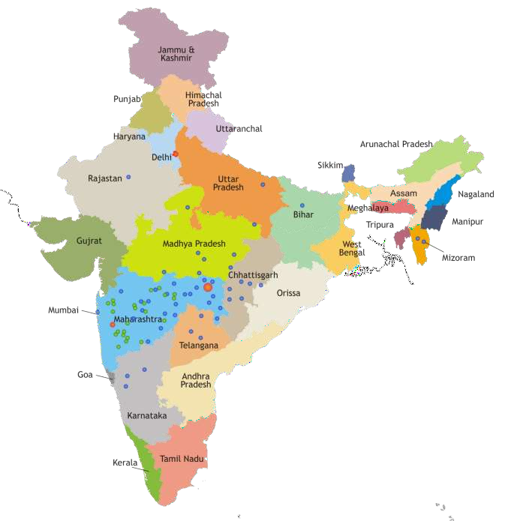

Client Geography!

Slide 16



